Slide 1


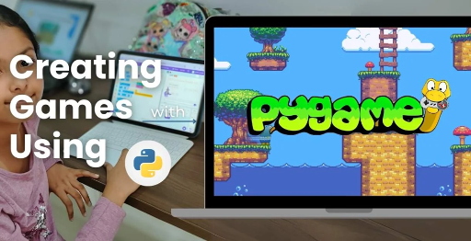
Session 2
Display & Window Management

Slide 2
Learning Objectives
Understand game inspiration, install Pygame-CE, navigate project structure
Detailed Objectives:
Understand the inspiration behind OMOGAME: Siege of Avaria! (two-player strategy, bird launching, fortress destruction).
Install Python and Pygame-CE and set up the development environment.
Navigate the project directory structure and understand the role of each file.
Run a basic Pygame-CE script to display a window.
Detailed Objectives:
Learn how to initialize a Pygame-CE window and manage display updates.
Understand the game loop (events, update, render).
Load and display a background image to set the game’s visual theme.

Slide 3
Practical Tasks
Understand game inspiration, install Pygame-CE, navigate project structure
Below is the list of Practical Tasks:
Modify main.py to create a game loop that handles window closing and refreshes the screen at 60 FPS.
Add code to load a background image (e.g., a sky or battlefield) from the media/ folder and display it.
Experiment with changing the window size and background color.
Discuss the importance of consistent screen updates for smooth gameplay.

Slide 4
Here we are going to create a blank window were we will going to make omo-game
Imagine this: You just opened a clean notebook to draw — the notebook is your game screen, and the table is your computer.
Now let’s make your own digital "My First Game!" using code!
Code:
import pygame
pygame.init() # Start Pygame
# Create a window that's 800 pixels wide and 600 pixels tall
screen = pygame.display.set_mode((800, 600))
# Give the window a name
pygame.display.set_caption("My First Game!")
# Main game loop

Slide 5
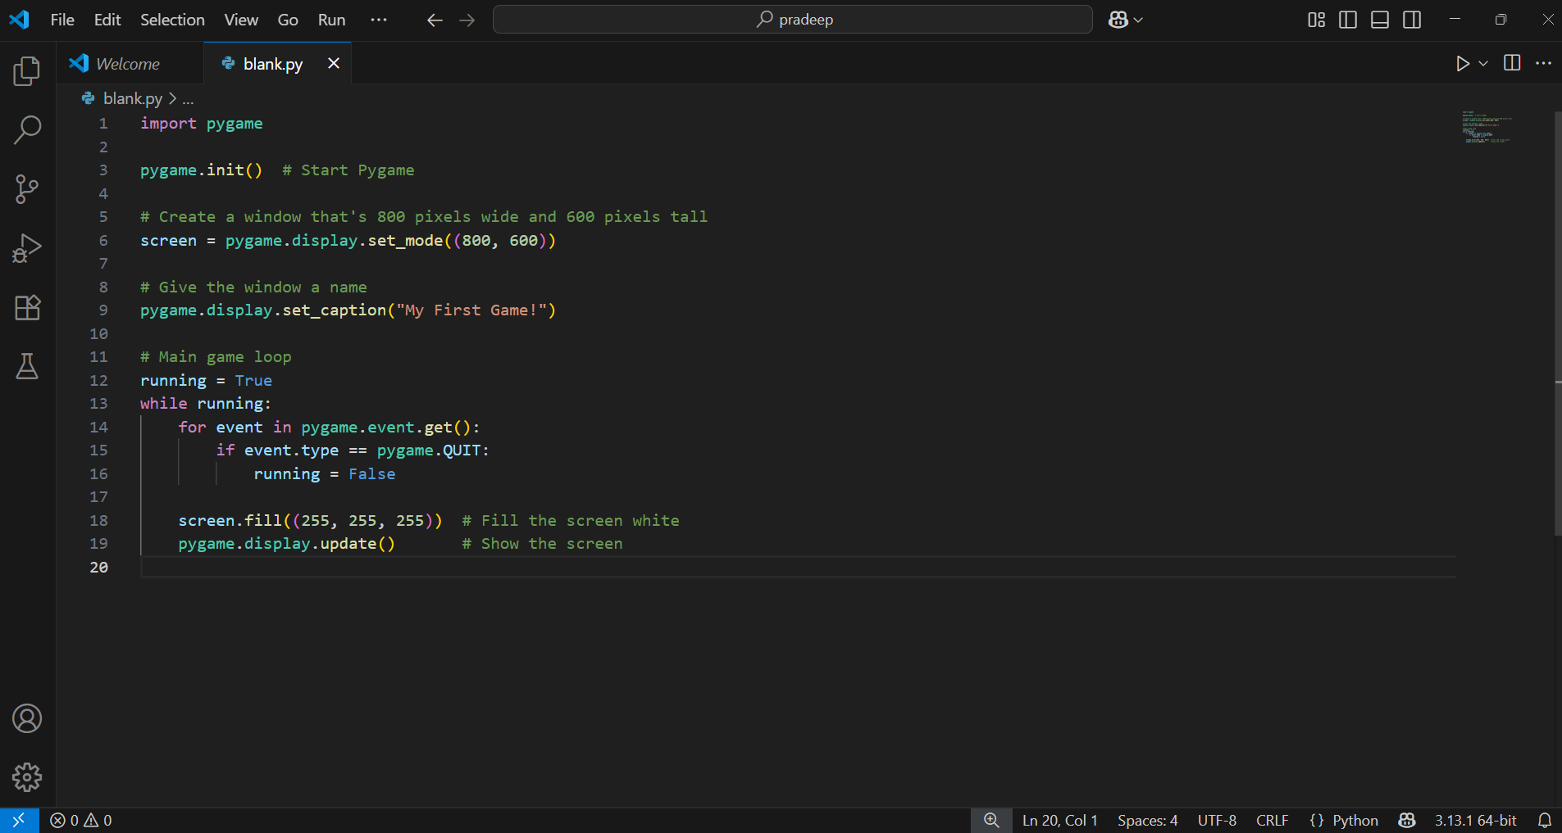
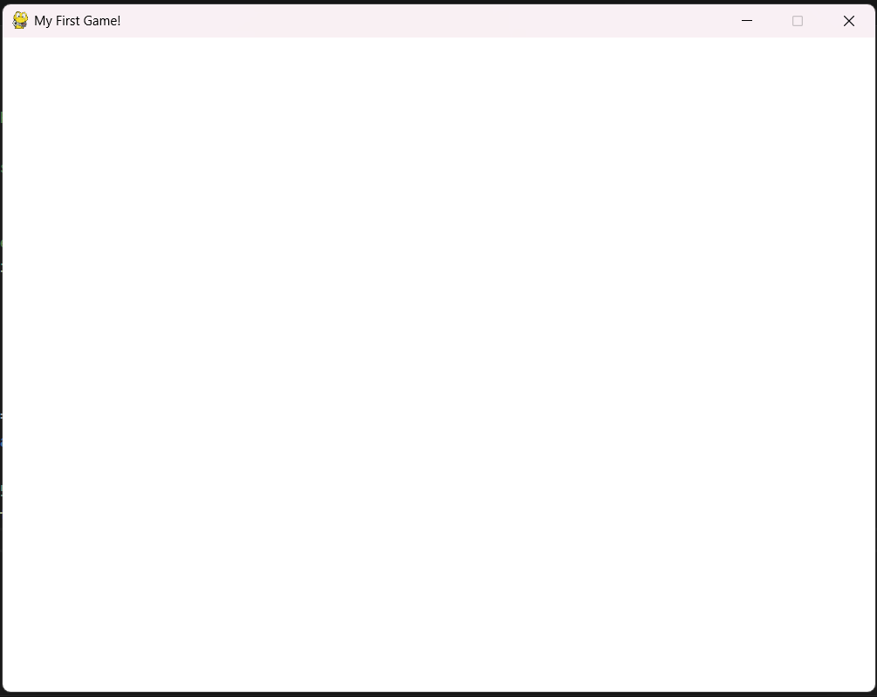
running = True
while running:
for event in pygame.event.get():
if event.type == pygame.QUIT:
running = False
screen.fill((255, 255, 255)) # Fill the screen white
pygame.display.update() # Show the screen
What It Does:
Shows a blank white window
You can close it using the ❌ button OUTPUT:-
You just made your first game screen!

Slide 6
Explanation of the code:-
import pygame
This line tells Python to use Pygame, a special tool to make games.
pygame.init()
🔹 This starts Pygame — kind of like turning on the lights before playing.
🔹 It sets up everything Pygame needs to run the game.
screen = pygame.display.set_mode((800, 600))
🔹 This creates the game window where everything will appear.
🔹 It is 800 pixels wide and 600 pixels tall — like setting the size of your screen or canvas.
pygame.display.set_caption("My First Game!")
🔹 This sets the name/title of the window.
🔹 You’ll see "My First Game!" at the top of your game window
running = True
while running:

Slide 7
Explanation of the code …
🔹 This is the main game loop — it keeps repeating (like a heartbeat) until you close the game.
for event in pygame.event.get():
if event.type == pygame.QUIT:
running = False
🔹 It checks for events — like clicking the ❌ close button.
🔹 If you click the close button, it stops the loop and closes the game.
screen.fill((255, 255, 255))
🔹 This fills the entire screen white — (255, 255, 255) is the color code for white.
🔹 You can change it to (0, 0, 0) for black, (255, 0, 0) for red, etc.
pygame.display.update()
🔹 This updates the screen — so anything you've drawn or filled appears.
🔹 Without this, nothing would show up even if you filled the screen.

Slide 8
Now we are going to learn how to Load and display a background image to set the game’s visual theme:
Source Code:
import pygame
pygame.init()
# Create a window
screen = pygame.display.set_mode((800, 600))
pygame.display.set_caption("Game with Background!")
# Load the background image
background = pygame.image.load(r"omogame\Angry-Birds-using-PyGame-CE\media\background.PNG")
background = pygame.transform.scale(background, (WIDTH, HEIGHT))
# Main game loop
running = True
while running:
for event in pygame.event.get():
if event.type == pygame.QUIT:
Here we have to upload the file path of that image

Slide 9
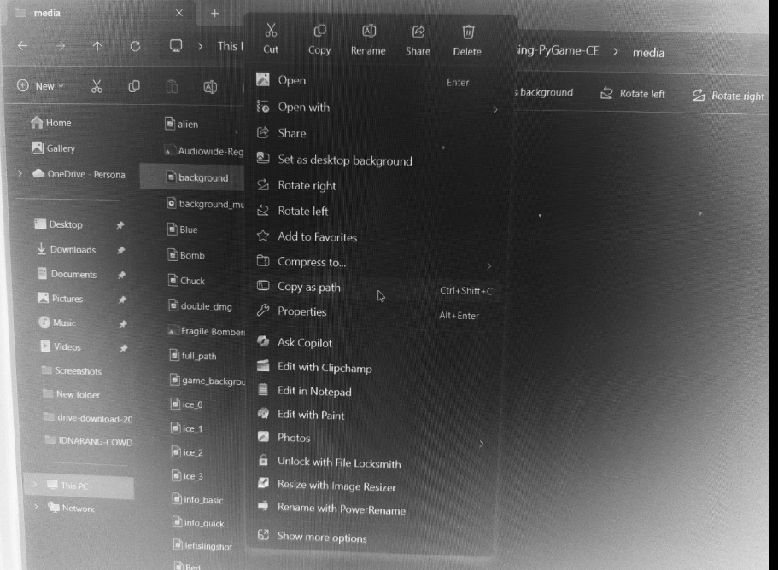
running = False
# Draw the background image at top-left corner
screen.blit(background, (0, 0))
pygame.display.update()
Note:
Make sure your image file is not too large (800x600 works well).
You can use .jpg, .png, or .bmp image files.
In the above code we have copied the file path and pasted it just check above,before the path we have added “r” that is called raw string literals.
How to copy a file path?
Here is the image in which get how to copy the file path of any file.
Just right click on the file you will see multiple options like this but we have to select copy as a path option to copy it.

Slide 10
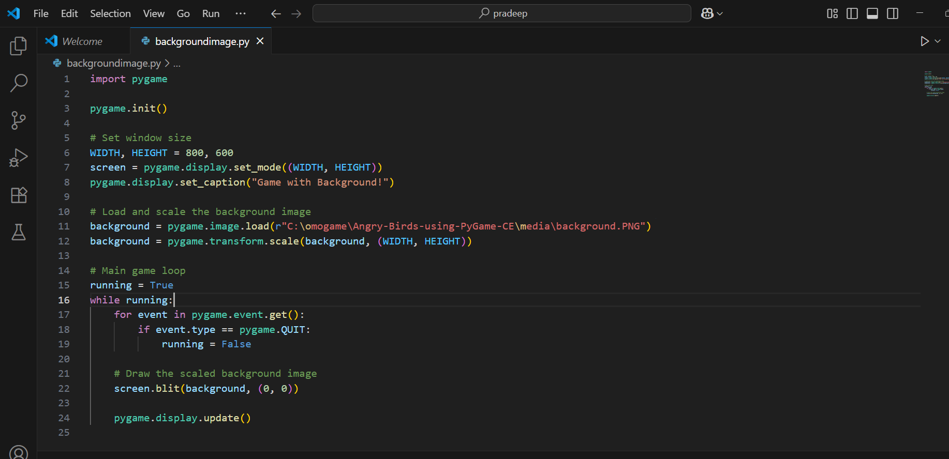
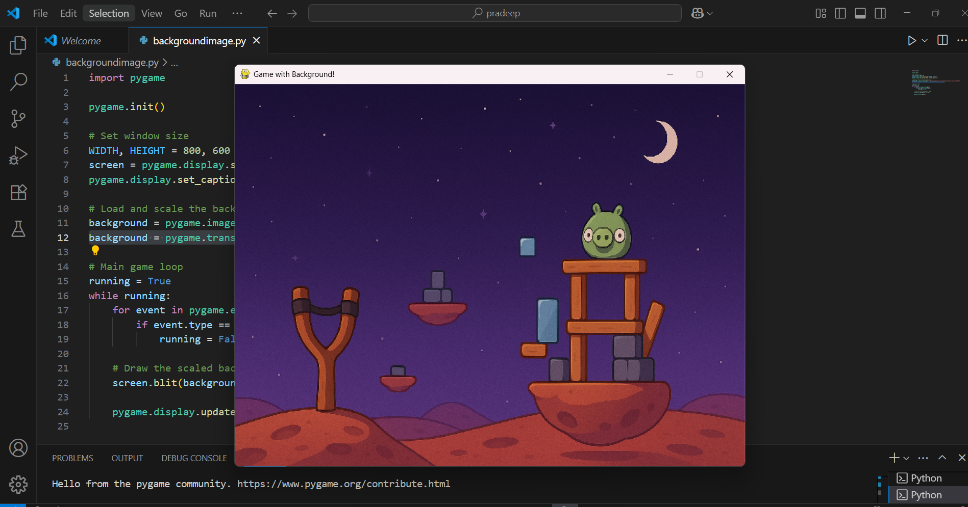
Here is the image of the code and its output :
Code:-
Output:

Slide 11
Explanation of the code:-
background = pygame.image.load(r"omogame\Angry-Birds-using-PyGame-CE\media\background.PNG")
This loads your background image from your computer. Make sure the file path and image name are exactly correct!
Tip: The r before the path (raw string) helps avoid errors from \ in Windows file paths.
background = pygame.transform.scale(background, (WIDTH, HEIGHT))
pygame.transform.scale(...) This is a function that resizes (scales) an image surface in Pygame. background (first part) This is the image you've already loaded using pygame.image.load(...).
(WIDTH, HEIGHT) This is the new size you want the image to be. In your case: (800, 600).
background = This means you're replacing the original image with the resized version, so you can draw it correctly on the screen

Slide 12
screen.blit(background, (0, 0))
This draws the background image onto the screen at position (0, 0), which is the top-left corner.
pygame.display.update()
This updates the screen, so your background image actually appears.
Think of it like pressing "refresh" to show new drawings.

Slide 13
According to the file structure of the game we are going to create main.py file and learn about FPS
Here we are going to Modify main.py to create a game loop that handles window closing and refreshes the screen at 60 FPS.
What is FPS?
FPS (Frames Per Second) controls how smooth your game feels. If FPS = 60, the game updates 60 times every second, which is standard for smooth animations.
Code:
import pygame
# Initialize Pygame
pygame.init()
# Set window size
WIDTH, HEIGHT = 800, 600
screen = pygame.display.set_mode((WIDTH, HEIGHT))
pygame.display.set_caption("OMO-GAME: Siege of Avaria!")

Slide 14
# Load and scale background image to fit the window
background = pygame.image.load(r"omogame\Angry-Birds-using-PyGame-CE\media\background.PNG")
background = pygame.transform.scale(background, (WIDTH, HEIGHT))
# Create clock to manage FPS
clock = pygame.time.Clock()
# Main game loop
running = True
while running:
# Handle close button
for event in pygame.event.get():
if event.type == pygame.QUIT:
running = False
# Draw background image
screen.blit(background, (0, 0))
# Update the screen
pygame.display.update()
# Limit to 60 frames per second

Slide 15
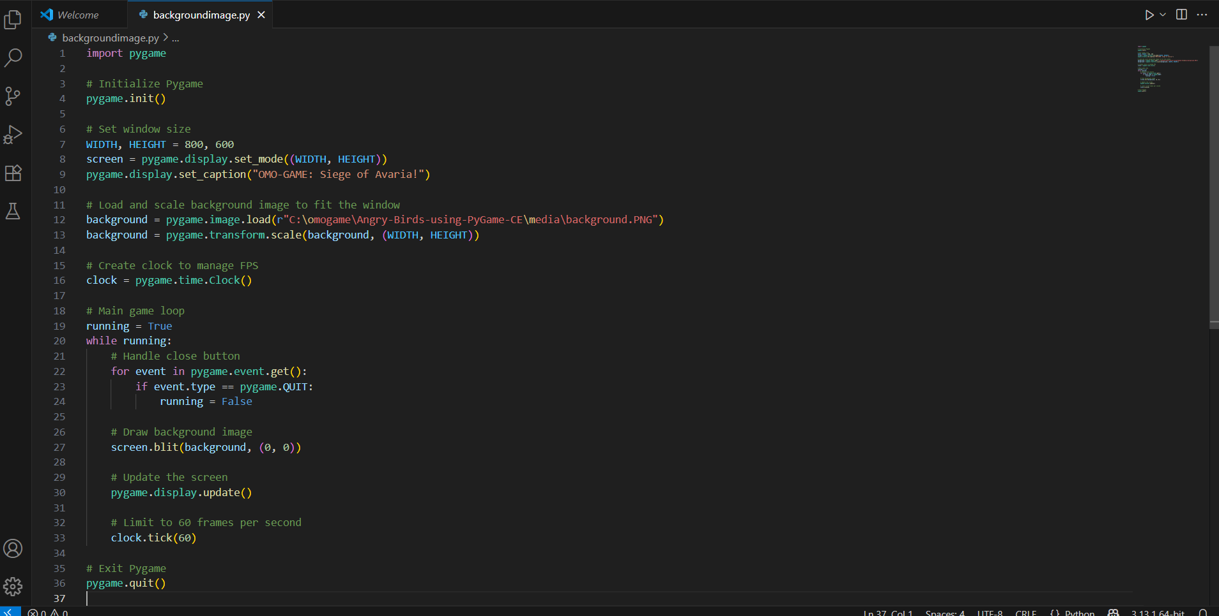
clock.tick(60)
# Exit Pygame
pygame.quit()
Notes:
Make sure the image path is correct. You can also use a relative path like:
Complete
Code:-

Slide 16
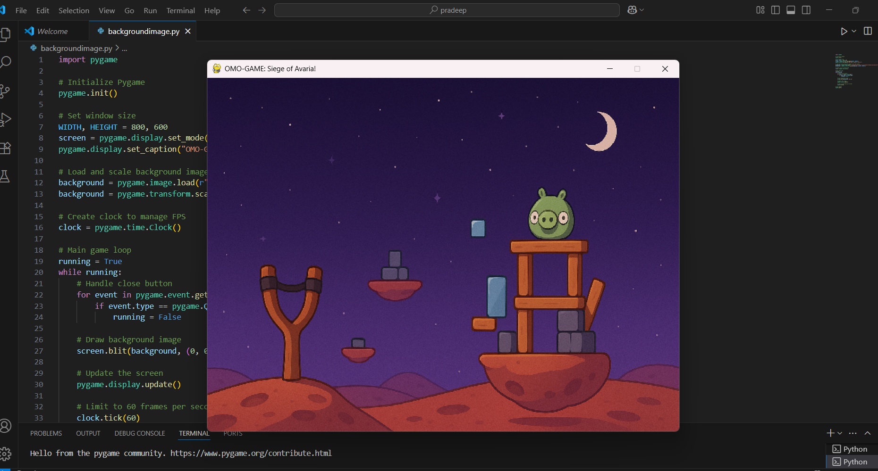
Output:
Explanation of the code:
clock = pygame.time.Clock()
This line creates a Clock object in Pygame, which helps you control how fast your game runs — specifically, the Frames Per Second (FPS).
Imagine the clock like a metronome for your game. It tells the game to wait just enough so it only updates 60 times in one second (or whatever number you set).

Slide 17
Student Experiment – Custom Window Design
🎮 Student Experiment – Custom Window Design
💡 Try this with your team:
Change window size: 800x600, 1920x1080
Try different backgrounds (sky, battlefield, jungle)
Add background music or ambient sound (bonus!)
Team challenge: Customize the game window!
Try window sizes: 800x600, 1920x1080 in main.py.
Experiment with backgrounds: sky, battlefield, jungle from media/.
Optional: Add background music or ambient sound for immersion.
Modify main.py to test changes and observe visual/performance impacts.
Share results to compare designs and functionality.

Slide 18
Student Task – Build Your Own Game Start Screen
🎮 Student Task – Build Your Own Game Start Screen
✅ Deliverables:
Functional game loop
A loaded image background
Exit button working properly
Customized window title
Deliverables:
Functional game loop with event handling.
Loaded background image from media/ folder.
Working exit button for proper game closure.
Customized window title (e.g., "My Siege of Avaria").
Save as: 📂 my_game_start.py.
Test in main.py to ensure functionality.
Submit for feedback on design and implementation.

Slide 19
Session Recap & Design Tips
🎮 Session Recap & Design Tips
✅ What you learned:
Setting up display window in PyGame
Game loop structure
Loading + rendering backgrounds
Frame rate control
💡 Tip: Your game’s first impression begins with a clean, responsive window.
What you learned:
Setting up a PyGame display window in main.py.
Structuring a game loop for real-time updates.
Loading and rendering backgrounds via assets.py.
Controlling frame rate for smooth gameplay.
Design tip: A clean, responsive window creates a strong first impression.
Next steps: Explore game_modes.py for Quick and Basic mode logic.
Reference: Pygame Official Documentation (https://www.pygame.org/docs/).

Slide 20

Exercise:
1. What is the primary objective of the Quick Mode in OMOGAME?
A) Collect all power-ups before the opponent
B) Launch birds without any destruction
C) Reach a score of 200 points
D) Complete the entire storyline
Answer: C) Reach a score of 200 points
2. Which file is considered the main entry point of the OMOGAME project? A) tools.py
B) main.py
C) assets.py
D) classes.py
Answer: B) main.py

Slide 21
Exercise..
3. What does the tools.py file mainly handle in the game?
A) Launching sound and animation
B) Player avatar selection
C) Collision detection and drawing functions
D) Managing game instructions
Answer: C) Collision detection and drawing functions
4. Which of the following is NOT listed as a unique feature of OMOGAME? A) Bird classes with special physics
B) Alien targets for bonus points
C) Multiplayer online matchmaking
D) Destructible block environments
Answer: C) Multiplayer online matchmaking

Slide 22
Usage in Game Loop:
clock = pygame.time.Clock() # create the clock
while running:
# game logic and drawing...
clock.tick(60) # limit to 60 FPS
pygame.time.Clock() is how you control the speed of your game loop and make your game run smoothly at a consistent frame rate.

Slide 23
Exercise…
5. Why is organizing the OMOGAME project into files like classes.py, media/, and game_modes.py important?
A) It reduces the game’s memory usage
B) It helps reduce the number of bugs completely
C) It makes the project look colorful
D) It simplifies managing and updating different game parts
Answer: D) It simplifies managing and updating different game parts

Slide 24

Session 2 VIDEO LINK
Display & Window Management

